Slide 1
HCI DESIGN CHALLENGE GROUP #29
Live on Sunshine
ASHUTOSH PANDA – DURGESH NANDAN – MALIK OSENI – ROHAN BHUJBAL – VEDANT PARAB

Slide 2




PHASES OF DEVELPPMENT
PHASE 1
PHASE 2
Ideation
Research & Empathize
PHASE 3
PHASE 4
Design
Conclusion
Table of Contents

Slide 3
PHASE 1 Problem Statement Brainstorming, Filter and Finalising Ideas,

Slide 4
PROBLEM STATEMENT
Climate change, driven by global warming and increased carbon emissions, poses a major threat. Local actions of millions contribute to displacement, resource competition, and disruption. Individuals, feeling their impact is limited, seek effective ways to address this complex issue.
The "think global, act local" mantra suggests a solution. However, implementing impactful local actions—such as reducing emissions, conserving energy, and promoting recycling—requires innovative approaches. Solutions include optimizing transportation, reducing dependencies on high-emission industries, and fostering self-sufficiency in energy and food.

Slide 5
PROBLEM STATEMENT CONT.
To empower individuals in mitigating climate change locally, innovative solutions are needed to bridge the gap between global challenges and individual actions.

Slide 6
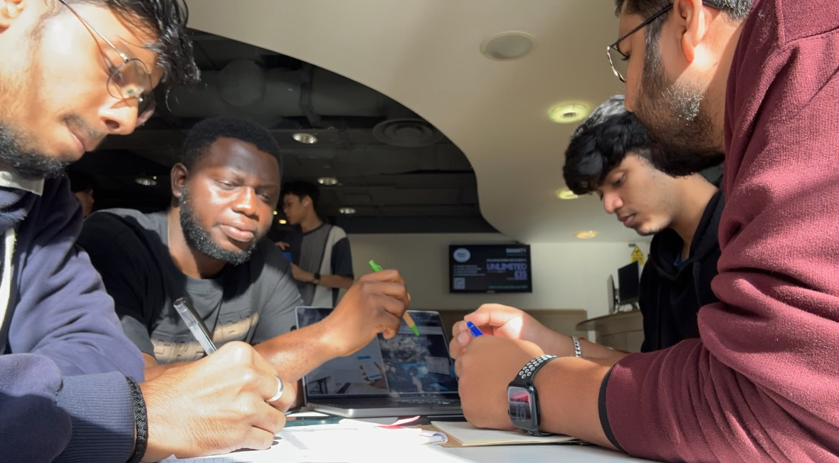

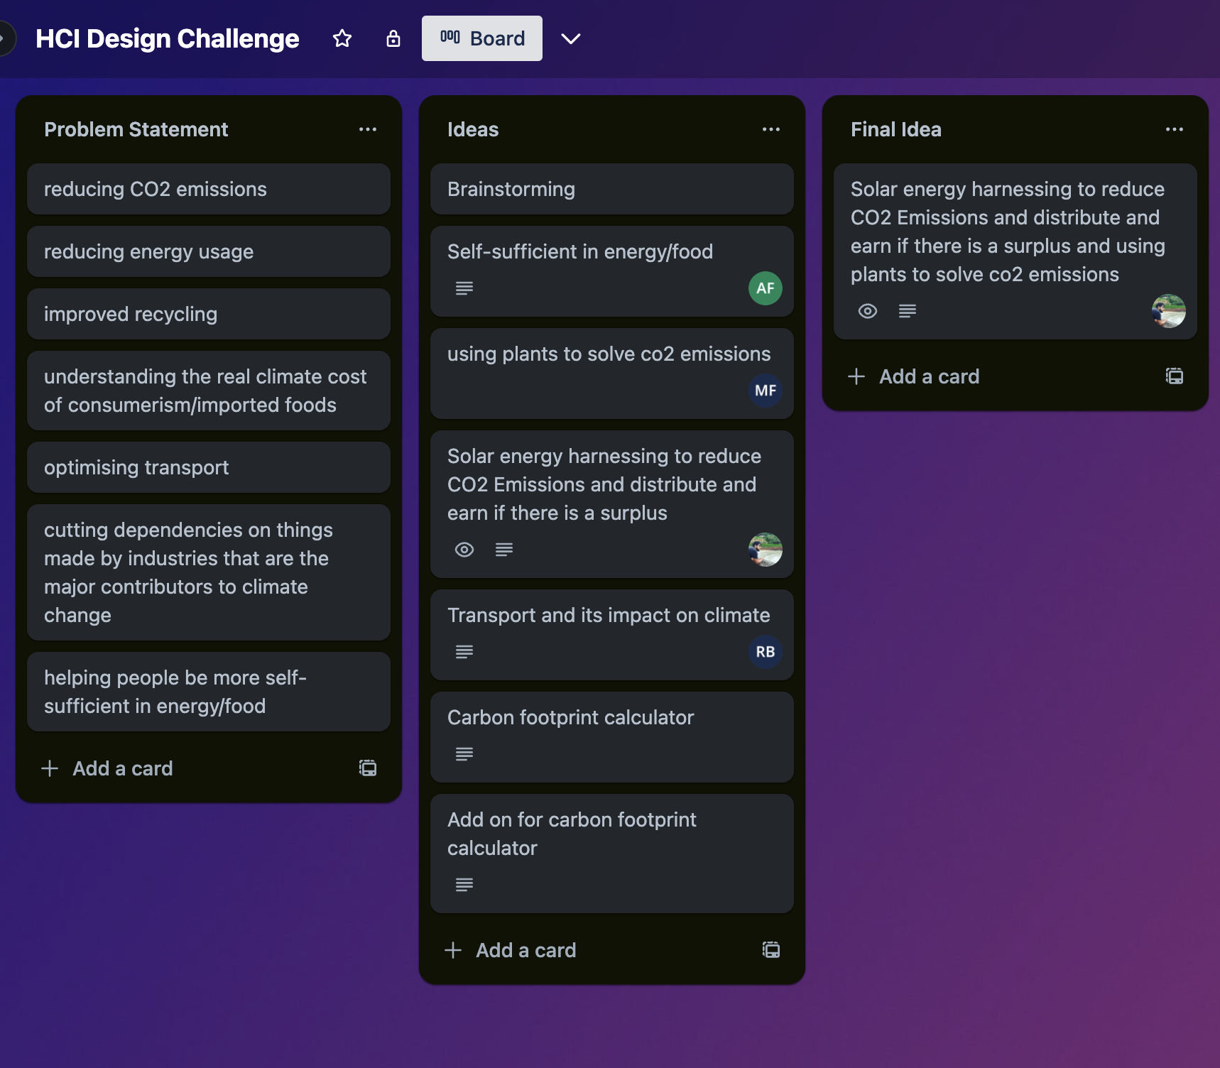
Brainstorming
Since we needed a solution that can help solve the ‘Climate change’ problem. The group started thinking about a solution which could help the cause. As each member of the group produced distinct ideas, we had to define them clearly and pick one which seemed the best idea.

Slide 7
Filtering Ideas
We went through a few brainstorming sessions and everyone in the team produced distinct ideas. This helped us to decide which idea should we go ahead with keeping in mind that it should reflect on the problem statement defined. We also had to investigate the feasibility of the solution and the market demography of the requirement of the product.
Self Sustainable Home
App with guided learning to the kitchen maintenance, gardening, and cooking using less energy.
Sustainable Transport
Find alternative ways to commute using carpooling, bikes, and EV vehicles, with route plan and journey planner
Carbon Footprint Calculator
Calculator that monitors individual contribution to carbon emission to make them aware.
Solar Tracker
Tracks the harnessing, usage, storage, and redistribution
Gardening App
A gamified app which uses VR and AI to promote home gardening and educate users about all aspects of gardening along with rewards for better engagement

Slide 8
Initial Idea
We decided to go ahead with the Solar tracker first as It was promising but the idea was too generic and there were organisations which are providing similar solutions to the customers.
Enphase
Enlighten
But they were not available across most regions are are relatively expensive. Also, the user engagement was less as there were not much of extra features, or gamifications involved.
[1] Enphase : https://enphase.com
[2] Enlighten : https://www.enlightensolar.energy/

Slide 9
Final Idea
In formulating our ultimate concept, we carefully evaluated
the initial two ideas, focusing on the central problem
statement and determining which one more effectively
addressed it.
The Solar Tracker concept involved monitoring individual
home energy consumption. Any surplus energy could be
shared among those in need, offering cash rewards. This
approach aimed to reduce power outages and provide clean
energy for those unable to afford solar installations,
subsequently reducing reliance on generators and
associated CO2 pollution.
The Gardening/Agricultural App explored IoT's potential to
collect plant health data through sensory devices, measuring
variables such as soil moisture, pH balance, and received
UV radiation.

Slide 10
Final Idea cont.
Recognizing the strengths of both ideas, we devised a
synergistic approach through gamification. In this system,
users can trade and share energy, acquire gardening skills,
and support farmers to enhance yields, all while earning
reward tokens for completing gardening tasks. This
integrated solution addresses the initial problem statement
and leverages the strengths of both concepts.

Slide 11
PHASE 2 Background Research, Understanding Users and Personas

Slide 12
Background Research
In our research, we narrowed our focus to India and Nigeria as our primary countries of interest. Our examination, based on statistics from each country, delved into their solar and electrical distributions, government support, the nature of blackouts and disasters, and the impact of Gamification on gardening.
Energy Data Study for India:
As of 2021, India stands as the fourth-largest global player in solar energy generation, boasting a capacity of 71.61GW AC.
With approximately 300 clear and sunny days annually, India possesses a remarkable solar potential of 5000 trillion kWh, surpassing its current energy output.
Bengaluru set a precedent by offering a ₹50 (63¢ US) rebate on monthly electricity bills for residents utilizing rooftop thermal systems.

Slide 13
Background Research
India faces a significant challenge of demand and supply shortages, particularly impeding rural development.
During the Indian summer, numerous regions experience daily power outages ranging from 2 to 8 hours. A survey across 272 districts revealed that 85% of households endure daily power cuts, with 57% facing up to 2 hours without electricity, and an additional 37% dealing with outages lasting 3-8 hours. Over 63% of households experience up to two power cuts daily, emphasizing challenges in power distribution.
Power distribution companies in India encounter hurdles due to high transmission losses and limitations in raising electricity tariffs.

Slide 14
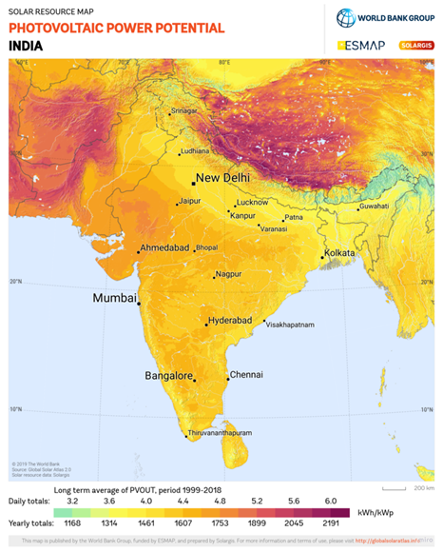
Photo-voltaic potential of India

Slide 15
Background Research
Energy Data Study for Nigeria:
On the global stage, Nigeria holds the 86th position in terms of solar power capacity installation (IRENA, 2022).
World Bank data (2023) indicates that 43% of Nigeria's population grapples with persistent power cuts.
Nigeria's installed electricity generation capacity stands at approximately 13,427 MW. However, the actual generation often falls significantly lower, averaging around 4,500 MW in 2022, as reported by the Federal Ministry of Power Nigeria.
This disparity between capacity and generation is primarily attributed to aging infrastructure, poor maintenance practices, and inadequate investment in the power sector (World Bank, 2022).

Slide 16
Background Research
Electricity distribution poses a challenge, with transmission and distribution losses estimated to be around 40%, as per the Federal Ministry of Power (2023).
Despite having abundant solar energy potential, with an average daily solar radiation of 5.08 KWh/m²/day, the adoption of solar power remains low. In 2022, only about 0.2% of Nigeria's electricity was sourced from solar, mainly due to the high upfront cost of solar panels, limited access to financing, and a lack of awareness regarding the benefits of solar power.
As an alternative, generators are widely used for energy backup in Nigeria, with an estimated 25 million generators in use, according to World Bank data (2022).
The use of generators in Nigeria results in the emission of over 20 million tons of carbon dioxide annually, equivalent to the emissions from approximately 10 million cars.

Slide 17
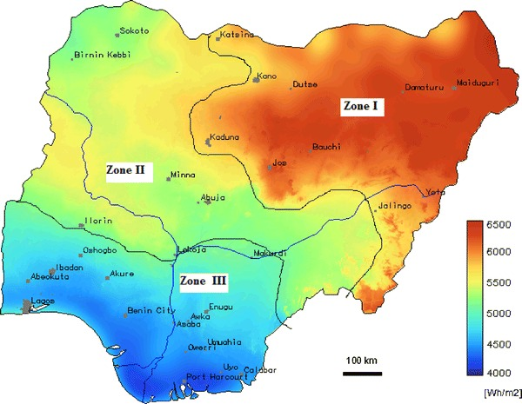
Photo-voltaic potential of Nigeria

Slide 18
Background Research
Governmental Outlook and Support:
In support of the national solar mission and clean-energy initiatives, the Indian government has allocated $130 million to the cause.
Nigeria has set a target to generate 30% of its electricity from renewable sources by 2030, as outlined by the Federal Ministry of Power in 2021.
To encourage the adoption of solar power, India provides subsidies for rooftop solar panel installations as part of its incentive programs.
In Nigeria, the government promotes solar power adoption through various initiatives, including tax incentives and financing schemes.
International organizations, including the World Bank, are actively providing financial and technical support to Nigeria to enhance its electricity infrastructure and promote the development of renewable energy.
India boasts a manufacturing capacity of 4.3 GW for solar cells and 18 GW for solar modules.

Slide 19
Background Research
Impact of Blackouts and Natural Disasters:
Approximately 43% of the Nigerian population experiences regular power outages.
In India, frequent and widespread power outages affect a substantial portion of households, with an estimated 34% reporting power cuts as of 2022.
These blackouts impede daily activities, hinder economic growth, and have a profound impact on essential services such as healthcare and education.
India contends with various natural disasters, including flooding, cyclones, earthquakes, and landslides.
Similarly, Nigeria faces natural disasters like floods, droughts, and oil spillage, posing significant threats to lives, livelihoods, and infrastructure.

Slide 20
Background Research
Impact of Gamification on Gardening:
The incorporation of gamification into gardening provides individuals with a sense of progress and accomplishment, fostering motivation through the completion of tasks and achievement of goals.
Essential elements of gamification, such as reward tokens and leaderboards, contribute to making gardening and agriculture enjoyable, attracting a broader audience to participate.
The gamified system effectively encourages users to enhance the quality of their plants and crops by cultivating interest and progression in their daily tasks.
Notable examples of gamification in gardening and agriculture can be observed in applications like Plantix, GardenTags, and Carrot Rewards.

Slide 21
Research Conclusion
The research delved into India and Nigeria's solar energy landscape, evaluating key aspects such as capacity, government support, challenges like blackouts and natural disasters, and the influence of Gamification on gardening. India, ranking fourth globally in solar energy generation, faces challenges like demand-supply shortages and frequent power outages affecting 85% of households. Bengaluru's rebate initiatives highlight local efforts. In Nigeria, ranked 86th in solar capacity, persistent power cuts and reliance on generators pose hurdles. Both countries receive government support, with India allocating $130 million and Nigeria targeting 30% renewable energy by 2030. Challenges include power outages affecting 43% in Nigeria and 34% in India. Gamification contributes to gardening motivation, with examples like Plantix and GardenTags.

Slide 22
Understanding Users
The user base for SunSync App system is diverse, attracting individuals dedicated to enhancing energy efficiency, environmental conservation, and farming productivity. The primary audience includes homeowners invested in solar energy, ranging from experienced solar panel users to those keen on minimizing their dependency on conventional energy sources. They are driven by the dual allure of economic gains from distributing excess energy and the ecological advantage of reducing carbon emissions.
Another distinct group within the user base includes gardeners and farmers, who are captivated by the system’s ability to use advanced IoT technology to track and bolster plant health. These users value concrete, information-based strategies to better their crop management and yield. The system’s gamified aspects are particularly appealing to those who relish a sense of competition and accomplishment, with real rewards for their active participation and successes in saving energy and enhancing their gardening practices.

Slide 23
Understanding Users
This integrated approach caters to individuals who are not only tech-savvy but also have a strong sense of community involvement. They appreciate the concept of a collective energy distribution network that provides support to those in need. The platform is designed to resonate with users who are not just looking for new learning experiences, like improving gardening know-how, but are also inspired by a system that promotes sharing of expertise and resources within a supportive community network.

Slide 24
Auto Ethnography
While conducting traditional Ethnography proved impractical due to the team's inability to visit India and Nigeria, we opted for Auto Ethnography based on our personal experiences. Our collaboration with individuals from both regions played a crucial role. A common trend emerged in the rural areas of both countries, revealing a significant dependence on grid power for daily necessities. This reliance resulted in frequent power interruptions and elevated expenses associated with conventional power sources such as coal and oils, notorious for their contribution to climate pollution. These challenges notably impacted the work and educational pursuits of individuals in these regions.
Even in urban areas where power cuts were fewer, the soaring expenses on energy remained a concern. Many households had solar panels, yet an abundance of surplus power was left unutilized. This realization sparked our team's initiative to channel this excess energy to those lacking reliable power access, offering it at a more affordable rate.
Moreover, several team members with a keen interest in gardening and farming faced challenges in achieving consistent yields. Variations in soil nutrient content across their lands hindered their efforts. This highlighted the need for modern and reliable soil analysis methods to support agricultural endeavours.

Slide 25
Auto Ethnography cont.
While conducting traditional Ethnography proved impractical due to the team's inability to visit India and Nigeria, we opted for Auto Ethnography based on our personal experiences. Our collaboration with individuals from both regions played a crucial role. A common trend emerged in the rural areas of both countries, revealing a significant dependence on grid power for daily necessities. This reliance resulted in frequent power interruptions and elevated expenses associated with conventional power sources such as coal and oils, notorious for their contribution to climate pollution. These challenges notably impacted the work and educational pursuits of individuals in these regions.

Slide 26
Questionnaire Design
To enhance the efficiency of our requirements gathering process and gain insights into user preferences, we formulated a survey with targeted questions. This survey was distributed across India and Nigeria through popular social platforms such as WhatsApp, Instagram, and Facebook. The questionnaire covered sections that aimed to gather information related to demographics, budget considerations, and interest in adopting renewable sources.
After internal evaluation, we commenced sharing the survey to collect responses. Subsequent slides delve into specific questions that served as crucial data points for refining the application's features. Additionally, this process helped identify unnecessary survey questions. Survey Link: Form Link

Slide 27
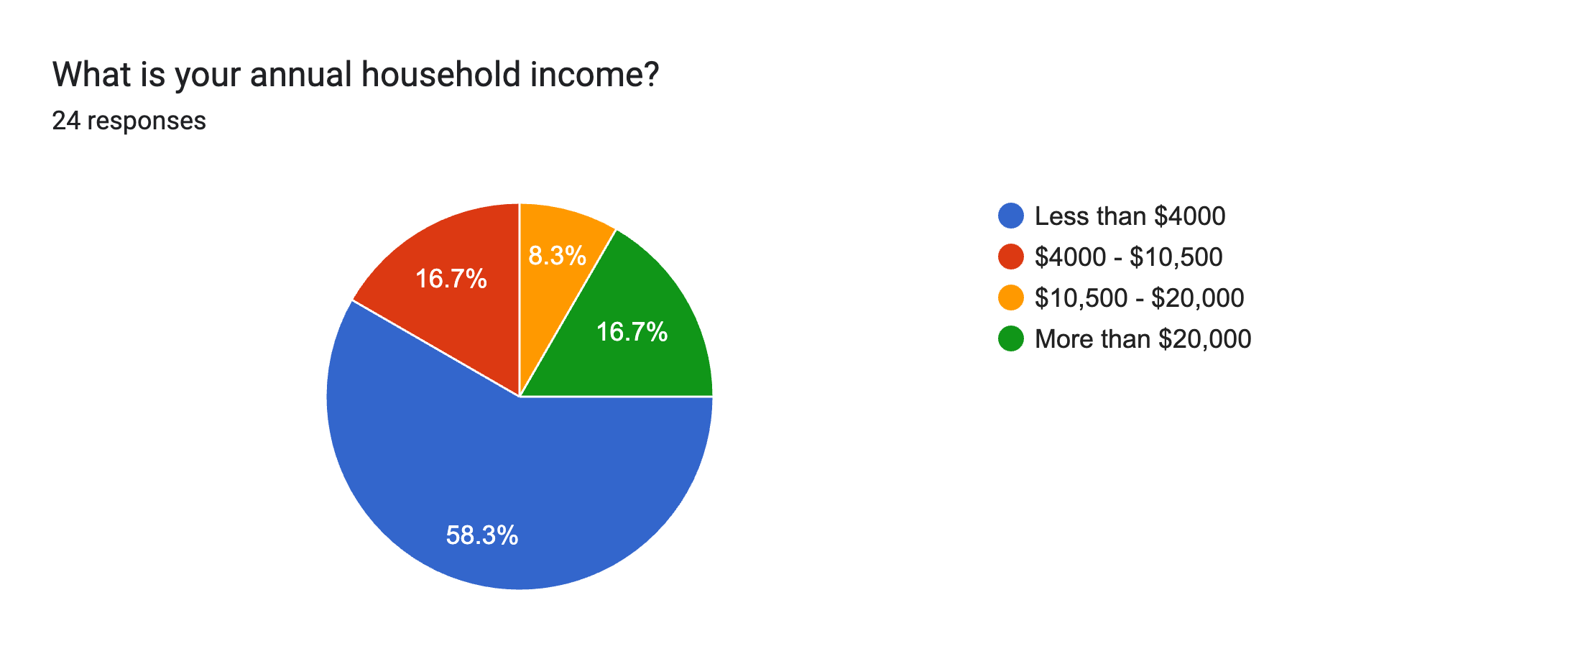
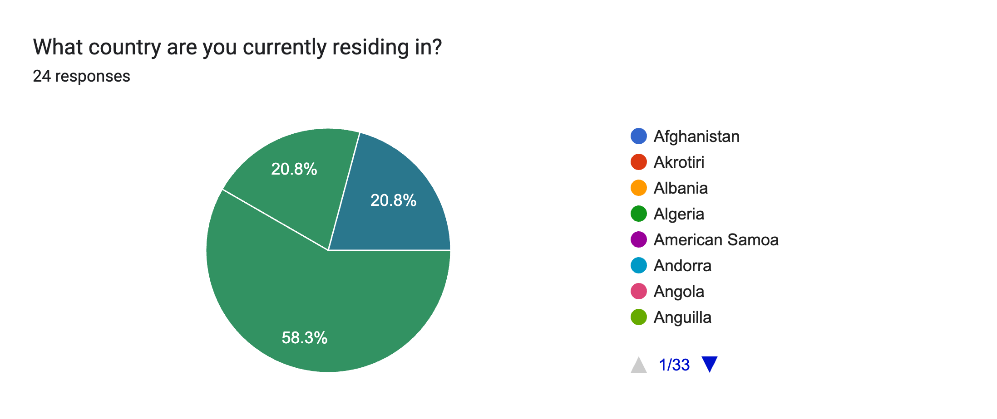
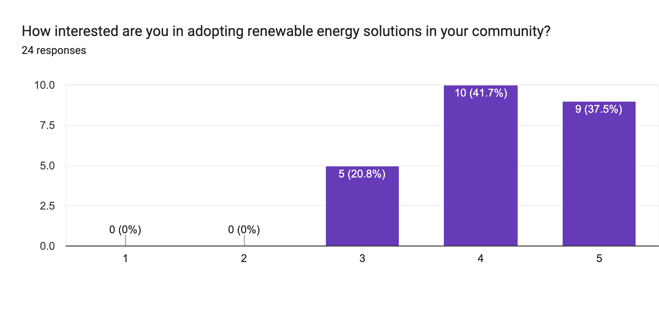
Questionnaire Results
The initial chart depicting annual household income reveals that a significant portion of survey participants earns less than $4000 annually, a sum deemed adequate for metropolitan living in India and Nigeria. The escalating costs of conventional electricity sources appear to be consuming a considerable portion of their income. This circumstance might be a driving factor behind their inclination towards the adoption of solar power, whether for sale, purchase, or a combination of both.
In the second graph, the survey's demographic breakdown indicates that 58.3% of respondents are from India, while 20.8% each are from Nigeria and the United Kingdom. The UK respondents, primarily students, pose challenges in determining their origin.
The third graph highlights a prevalent interest among surveyed individuals in embracing renewable energy solutions for their communities, with a majority expressing a strong inclination, as evident in the most likely category.

Slide 28
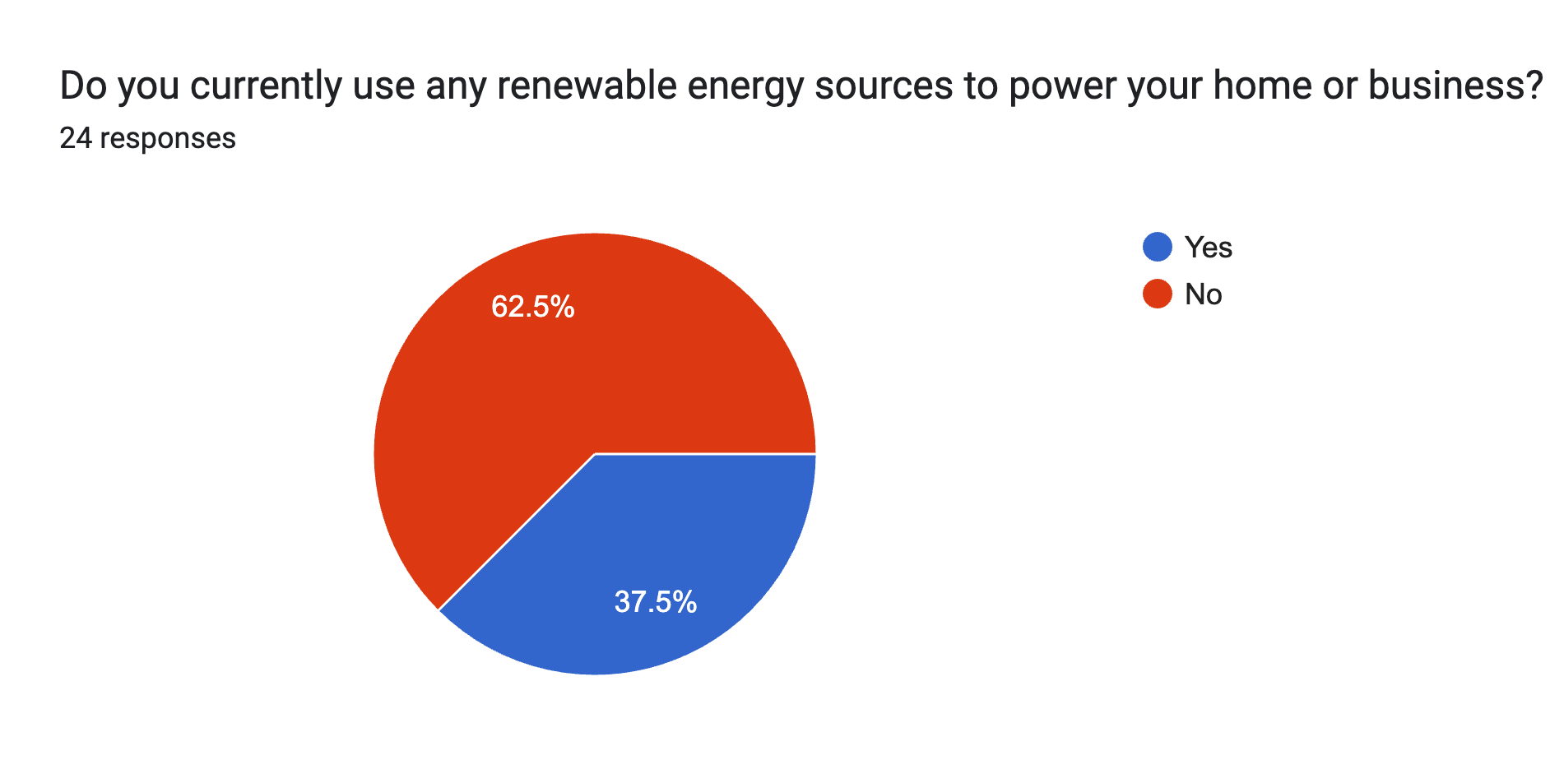
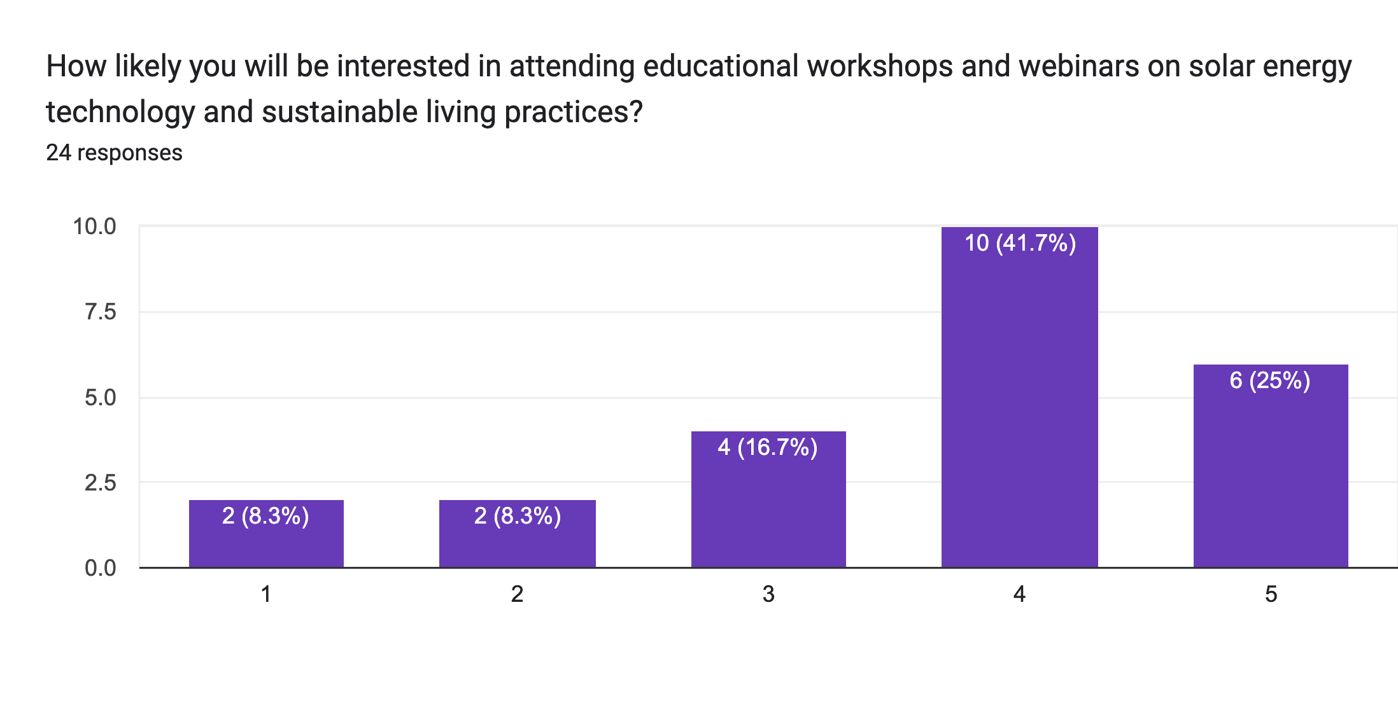
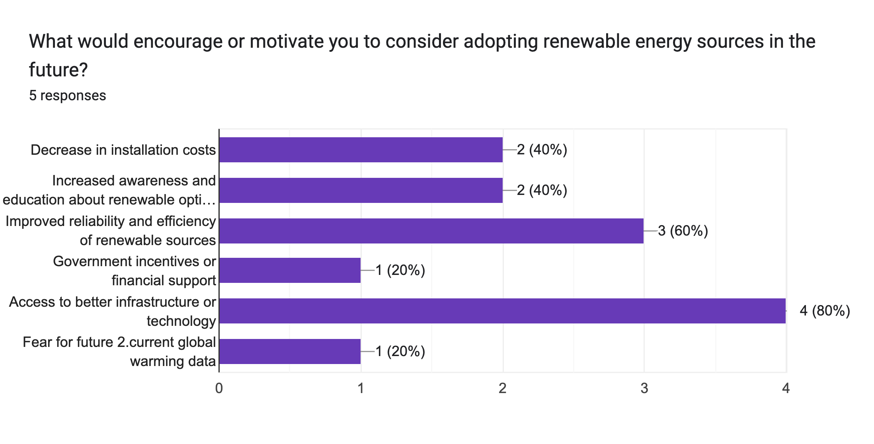
Questionnaire Results
The initial graph indicates that most participants currently do not incorporate any form of renewable sources in their homes or businesses. This significant gap suggests a favorable acceptance for our application, especially with effective awareness campaigns.
The second graph reveals an interest among individuals to participate in workshops and campaigns aiming to provide comprehensive insights into the implementation of solar energy solutions in their sustainable daily practices, along with the underlying technology.
Factors such as improved infrastructure and technology access, enhanced reliability and efficiency of renewable sources, reasonable installation costs, and heightened awareness serve as strong motivators for individuals. Notably, government incentives, as outlined in the third graph, rank lower in participants' concerns.
95.8%
Participants between 18-65

Slide 29
Yes. It cost a lot at time of installation, but it save a lot of money in future and now there is no fear of power cut at emergency time. - participant answer
Do you believe that using renewable energy sources is feasible or suitable for your specific living or working conditions? Please explain.

Slide 30
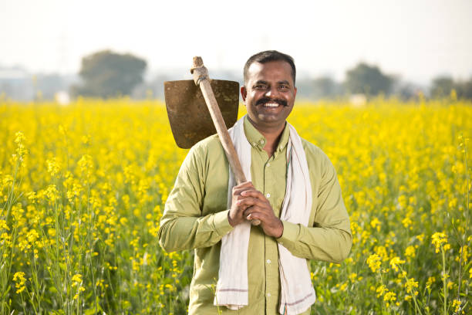
Personas #1
PERSONAS
Goals:
To reduce reliance of the Grid Power.
To Reduce reliability of traditional fuel sources is due escalating expenses.
Live more sustainable and environment friendly lifestyle.
Needs:
A reliable and affordable source of power.
A user-friendly app that makes it easy to monitor their Soil Statistics in the area.
Educational resources on solar power maintenance and troubleshooting in native languages
Ryomen Thakkar
Age: 39
Gender: Male
Occupation: Farmer
Education: Uneducated
Birthplace: India
Location: Rural
Income: < $4,000
Bio:
Ryomen, a 39-year-old farmer, needs to work day and night to achieve a good crop yield. However, frequent power cuts in his area result in less efficient farming practices, impacting his lifestyle significantly as farming serves as his primary source of income.

Slide 31

Personas #2
PERSONAS
Goals:
To avoid relying on the grid due to inconsistent and expensive power, and instead, utilize other renewable sources to maximize profits.
To have a passive source of income
Needs:
A method to utilize solar energy for the farm, enhancing efficiency, and maximizing profits.
An app that simplifies energy usage and monitoring of crops across the land.
Reliable support and services provided by the app developers for solar equipment.
Gojo Adebayo
Age: 45
Gender: Male
Occupation: Farmland Manager
Education: BSc Humanities
Birthplace: Nigeria
Location: Rural
Income: $9,000
Bio:
Gojo , 45, manages a family-owned agricultural land spanning several acres. He leases sections of his land to tenant farmers for seasonal cultivation of various crops. Managing the land and ensuring its profitability are crucial aspects of his responsibilities.

Slide 32

Personas #3
PERSONAS
Goals:
Reduce environmental impact from the use of traditional fuel sources.
Generate additional income from surplus solar energy.
Contribute to the Solar Power Sharing movement.
Needs:
An advanced app offering reliable and precise information on solar power consumption and sharing.
A platform which provides easy access to power and light for individuals during power cuts.
An opportunity to participate in the sustainable energy usage movement.
Maki Sharma
Age: 25
Gender: Female
Occupation: Software Developer
Education: MSc Computer Science
Birthplace: India
Location: Urban
Income: $29,000
Bio:
Maki, a 25-year-old software developer, works a 9-5 job to sustain her life. She holds a passion for renewable energy usage and concerns about the future of upcoming generations. Additionally, she aspires to make a difference by providing energy access to remote areas where people currently lack this essential resource.

Slide 33

Personas #4
PERSONAS
Goals:
Reduce his Business electricity cost
Generate additional income from surplus solar energy.
Gain competitive advantage by being leader in sustainability.
Contribute to a more sustainable future for Nigeria
Needs:
An app providing clear and transparent pricing for sharing solar power.
A platform with dependable customer support services.
An opportunity to actively participate in fostering a sustainable future for Nigeria.
Nanami Igwe
Age: 37
Gender: Male
Occupation: Business owner
Education: BSc management
Birthplace: Nigeria
Location: Urban
Income: $21,000
Bio:
Nanami, a 37-year-old businessman, aims to revolutionize his business through sustainable energy practices. He possesses an unwavering commitment to improving the lives of people in Nigeria. Aspiring to become a pioneer in utilizing sustainable energy practices.

Slide 34
Scenarios #1
SCENARIOS
Ryomen Thakkar is a farmer in India who dedicates himself day and night to cultivating crops for his livelihood. He faces challenges due to unreliable access to electricity and the rising costs of traditional fuel sources. As a result, his farm operations heavily rely on a steady Grid power supply for crucial irrigation pumps and machinery necessary for crop cultivation.
One day, while conversing with a fellow farmer, Ryomen discovers SunSync, an innovative app enabling the sharing of solar power among users. Intrigued, Ryomen decides to explore the app further. After researching it, he recognizes its potential to increase his crop yield through soil analytics and reduce expenses on grid and traditional power sources. Ryomen signs up as a user on the app and follows the instructions provided by the customer support team.
Within a short period, Ryomen notices significant lifestyle changes. His reliance on grid and traditional power diminishes as he accesses affordable shared solar power from various contributors across the region. Not only was the price reasonable, but he also received a consistent energy supply and valuable insights about soil analytics, resulting in increased yield and overall improvement in his farming operations.

Slide 35
Scenarios #2
SCENARIOS
Gojo Adebayo, a farmland manager residing in Nigeria, oversees extensive agricultural lands across different neighborhoods dedicated to cultivating various crops. His primary focus is ensuring consistent and efficient crop yields, relying heavily on necessary irrigation and machinery that require a reliable power supply.
One day, while scrolling through social media, Gojo discovers SunSync, an app enabling the sharing of solar power among users. Intrigued by the concept, Gojo installs the app to learn more.
After researching SunSync’s features, Gojo realizes the app's potential to revolutionize his farmland operations by using solar energy to power irrigation and machinery, reducing dependence on unreliable grid power. He registers as a contributor and seeks assistance from customer support.
Implementing SunSync, Gojo installs solar panels across his farmlands, connecting them through the app. This step significantly reduces his farmland's electricity bills, providing cost-effective power across all agricultural sites. Moreover, the consistent power supply results and the accurate analytics in the app resulted in enhanced crop yields.

Slide 36
Scenarios #3
SCENARIOS
Maki Sharma, a 25-year-old software developer residing in an urban area of India, maintains a busy schedule filled with coding, attending meetings, and collaborating remotely with her team. She holds a strong enthusiasm for cultivating plants and contributing to environmental sustainability by actively participating in sustainable initiatives.
Residing in the heart of the city, Maki doesn't face frequent power cuts but worries about her escalating electricity bills. As an advocate for sustainable energy and the environment, she desires to switch to eco-friendly energy alternatives and contribute to helping those still lacking access to reliable energy.
While browsing online tech forums one day, Maki discovers SunSync, a revolutionary app facilitating solar energy sharing. Intrigued by its concept, she thoroughly explores the app and promptly registers as a Contributor.
Following to the app's contributor guidelines, Maki installs solar panels and links them to the app. Soon after, she observes substantial changes. Not only does she witness a noticeable reduction in her electricity bills, but she also notices that the soil analytics feature of the app contributes to the healthy growth of her plants. Moreover, being part of a community that shares energy with those lacking consistent access to power gives her a sense of fulfillment.

Slide 37
Scenarios #4
SCENARIOS
Nanami Igwe, a seasoned businessman residing in Nigeria, Struggling with increasing energy expenses and pressure to embrace sustainable practices. While his manufacturing company thrives, its heavy reliance on grid power renders it susceptible to frequent power cuts and exorbitant electricity bills.
One day, Nanami stumbles upon a news article about SunSync, an app facilitating the sharing of excess solar power among users. Intrigued, Nanami decides to register for the Contributors group within the app, keen to learn more and actively participate.
After diving into SunSync's features, Nanami becomes convinced that the app aligns with his goals. He proceeds to install solar panels on his facilities and integrates them with the app.
Within weeks, Nanami experiences the app's benefits firsthand. His energy expenses drastically reduce, and the company's dependence on the grid diminishes. Moreover, Nanami begins to earn passive income by sharing surplus solar power with others.

Slide 38
PHASE 3 Flow, Architecture Diagrams, Sketches, Wireframes, Prototypes, and Mockups

Slide 39
PHASE 4 Poster, Team, Work and Group Management

Slide 40
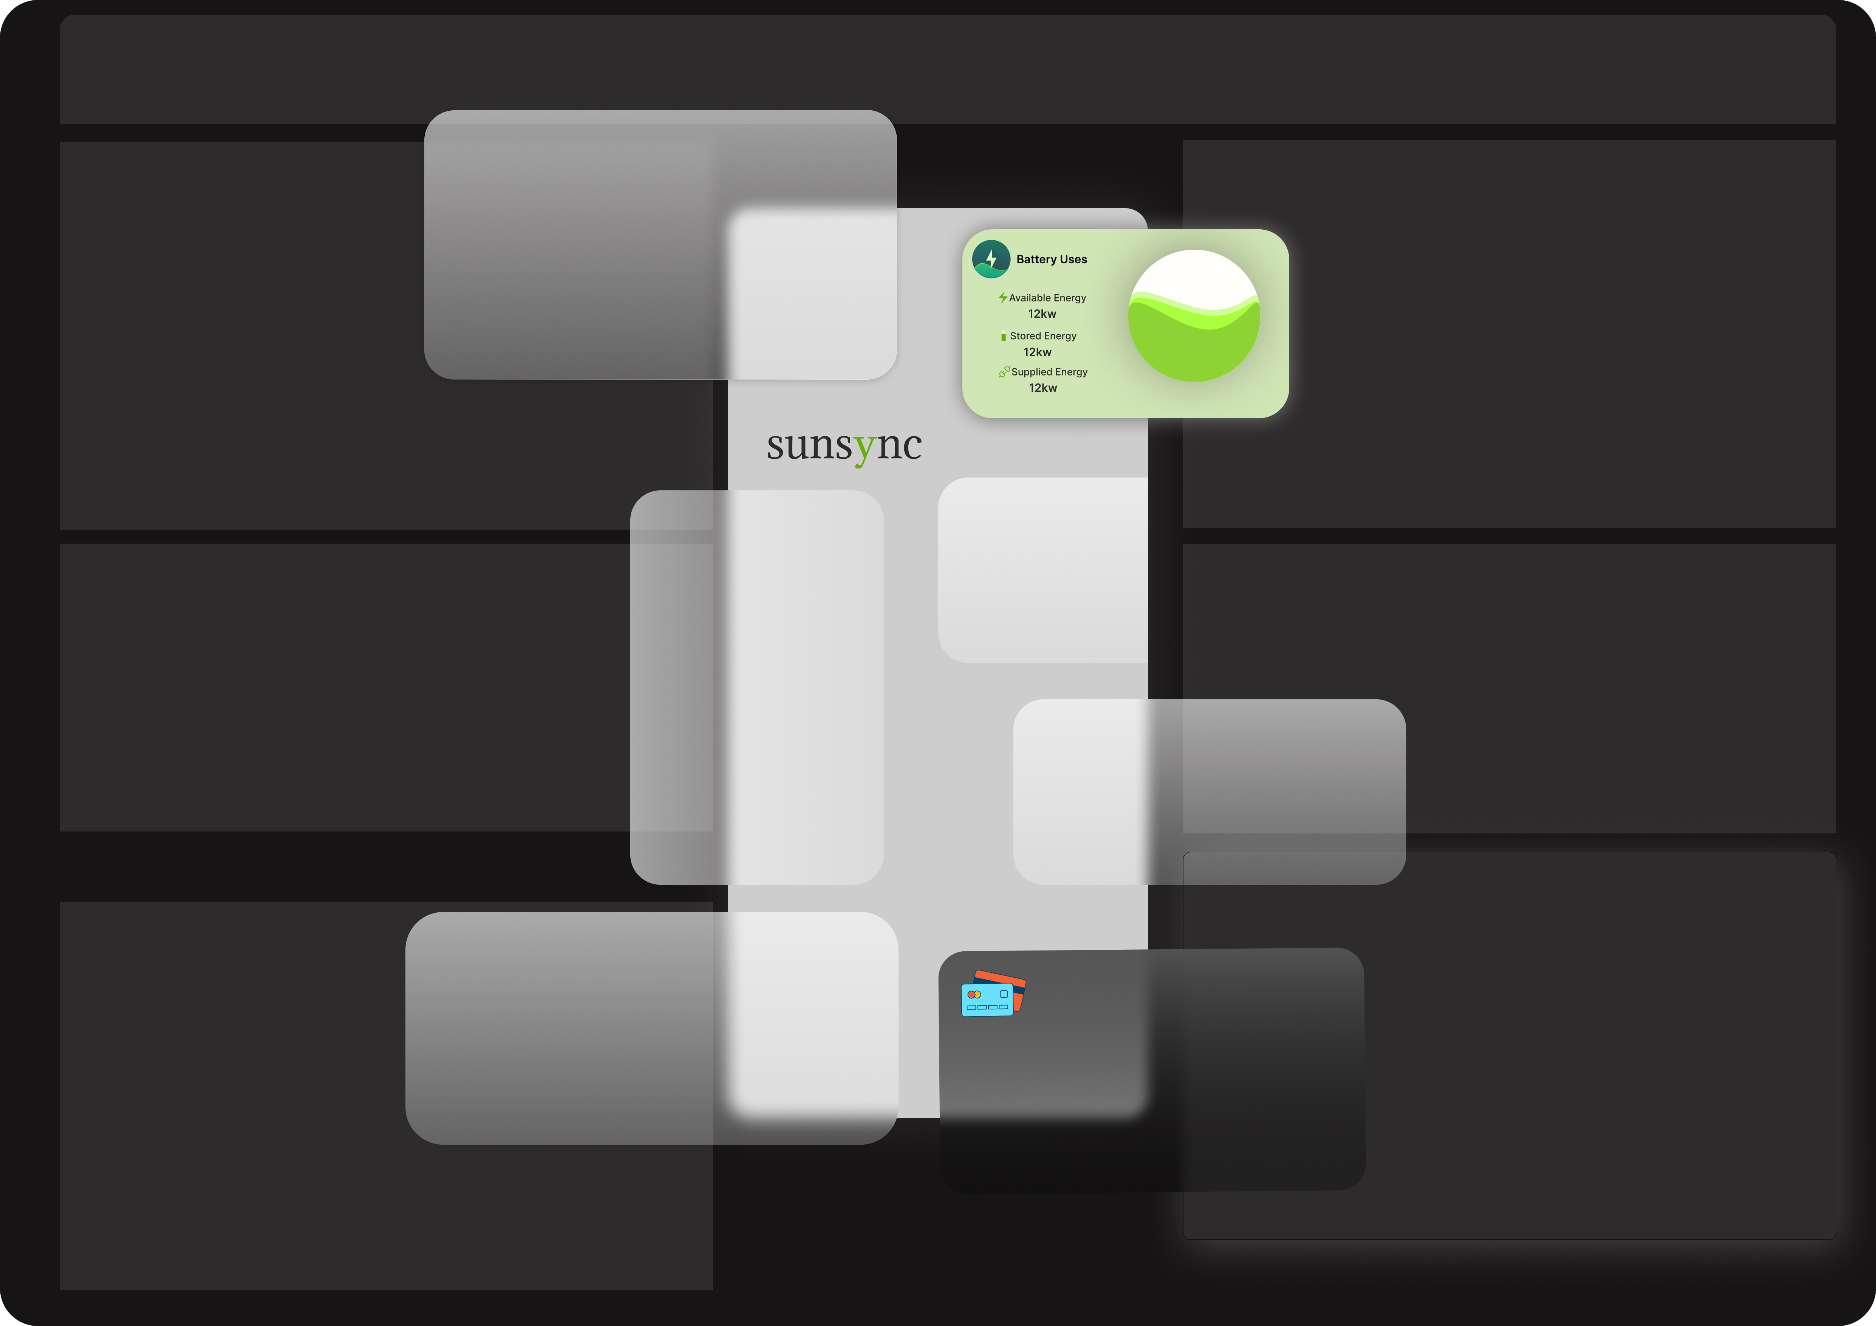
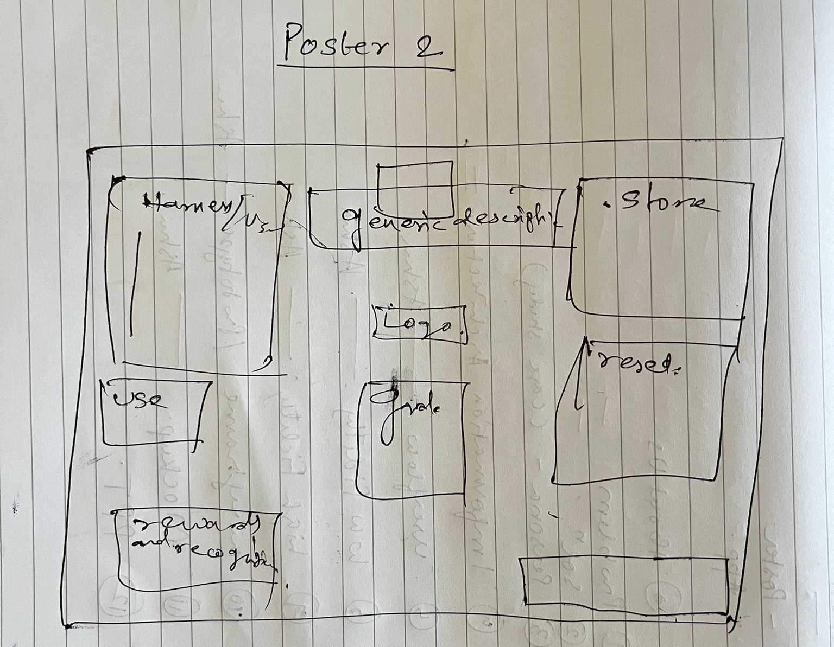
INITIAL POSTER AND POSTER RESEARCH
Initially we thought of making the poster with separate modules in the phone screen which are further extended in the dark theme. But data representation was not optimal so we drafted an idea with pen and paper and then used that design which is in the next slide

Slide 41
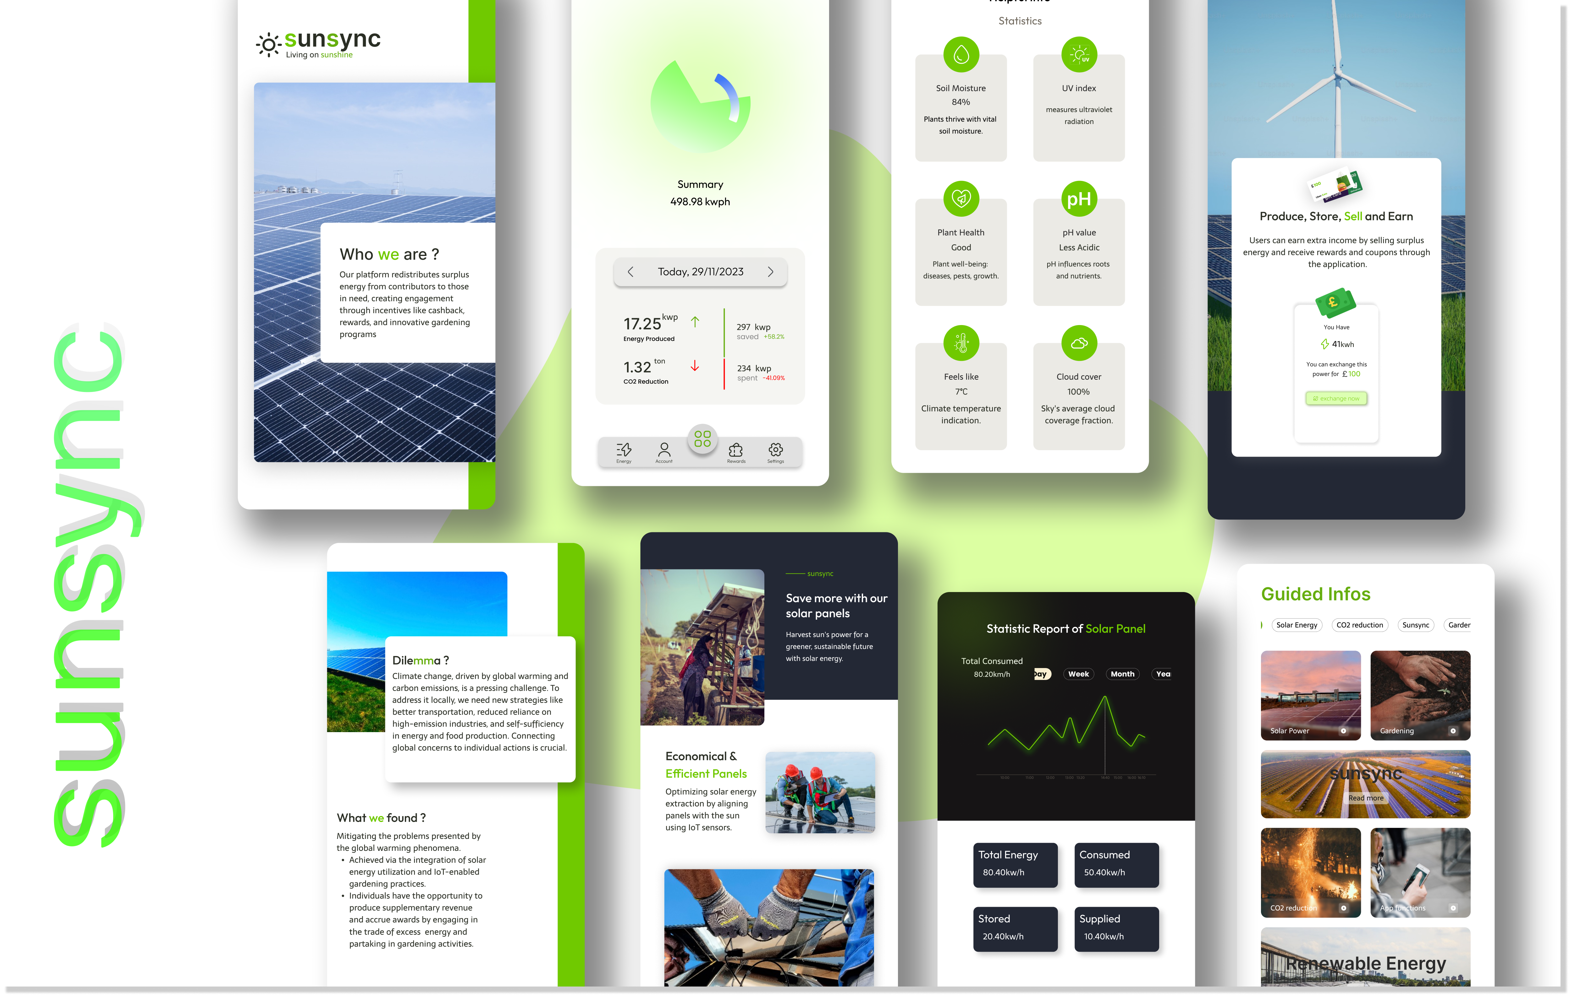
FINAL POSTER DESIGN
Full-size poster: Poster Link

Slide 42
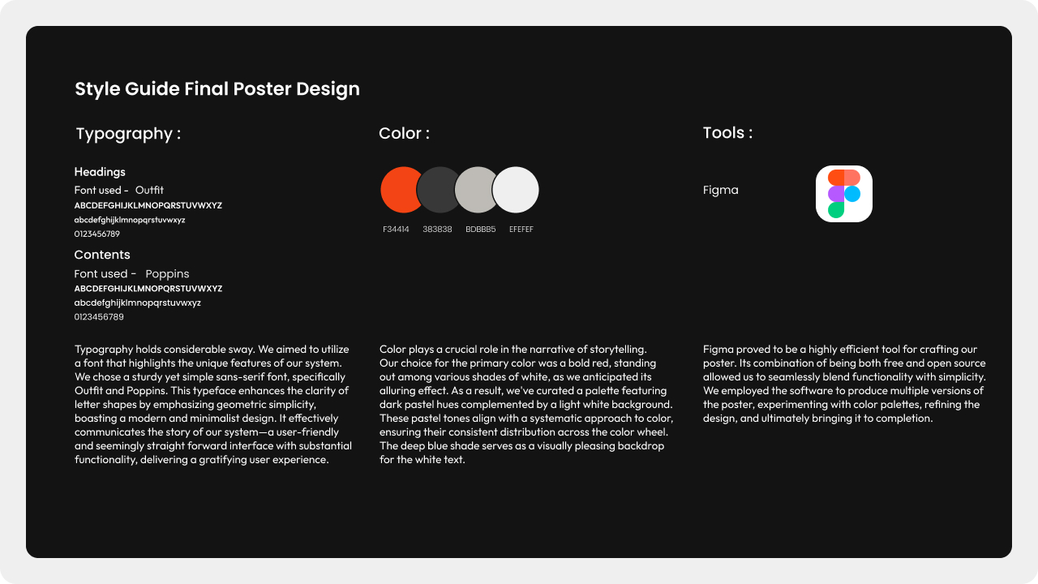
FINAL POSTER DESIGN STYLEGUIDE

Slide 43
Poster Design Review
The feedback received during the exhibition from both the professor and peers highlighted several positive aspects of the poster. They appreciated the eye-catching and well-organized card layout, noting that it effectively captured attention. The use of modern design practices was acknowledged as a strong point, contributing to the overall aesthetic appeal. However, a notable critique was directed towards the text size on the poster, with concerns raised about its potential impact on readability. The suggestion was made that smaller text might lead to a loss of interest among viewers. Additionally, there was feedback regarding the need for more efficient utilization of space within the poster, presenting an opportunity for improvement in the overall layout.

Slide 44


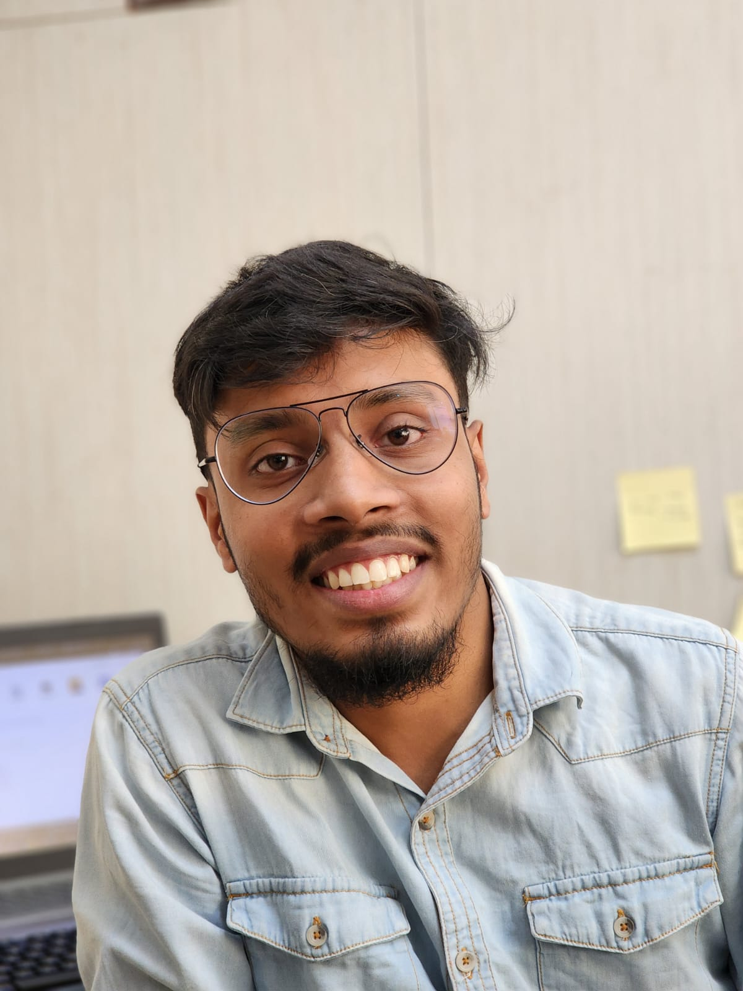
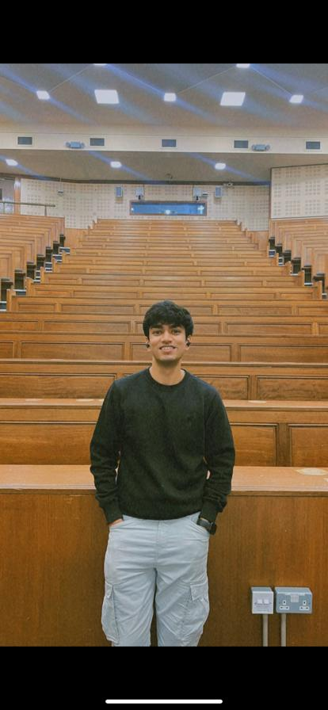
OUR TEAM
Durgesh Nandan
Oseni Malik
Ashutosh Panda
Rohan Bhujbal
Group Coordinator
Application Developer and Design Architect
UI/UX Designer
Data Gathering and Content Writing

Slide 45

OUR TEAM
Vedant Parab
Contributor

Slide 46
Division Of Work
We outlined the preferences and strengths of each team member and tailored user stories based on their skill sets. Each user story focused on a singular task. To ensure effective collaboration, we utilized a Trello board resembling a scrum board to monitor the progress of each story and track its stage.
Ashutosh, leveraging his expertise in UI/UX design, concentrated on tasks like sketches, wireframes, and prototypes. Malik delved into architecture diagrams and feature briefs. Rohan, serving as the content writer, gathered essential data for the application requirements. As a Full Stack Development expert, Durgesh took on the role of project coordinator, contributing to design, architecture, research, and development. Vedant contributed in surveys and analysis.

Slide 47
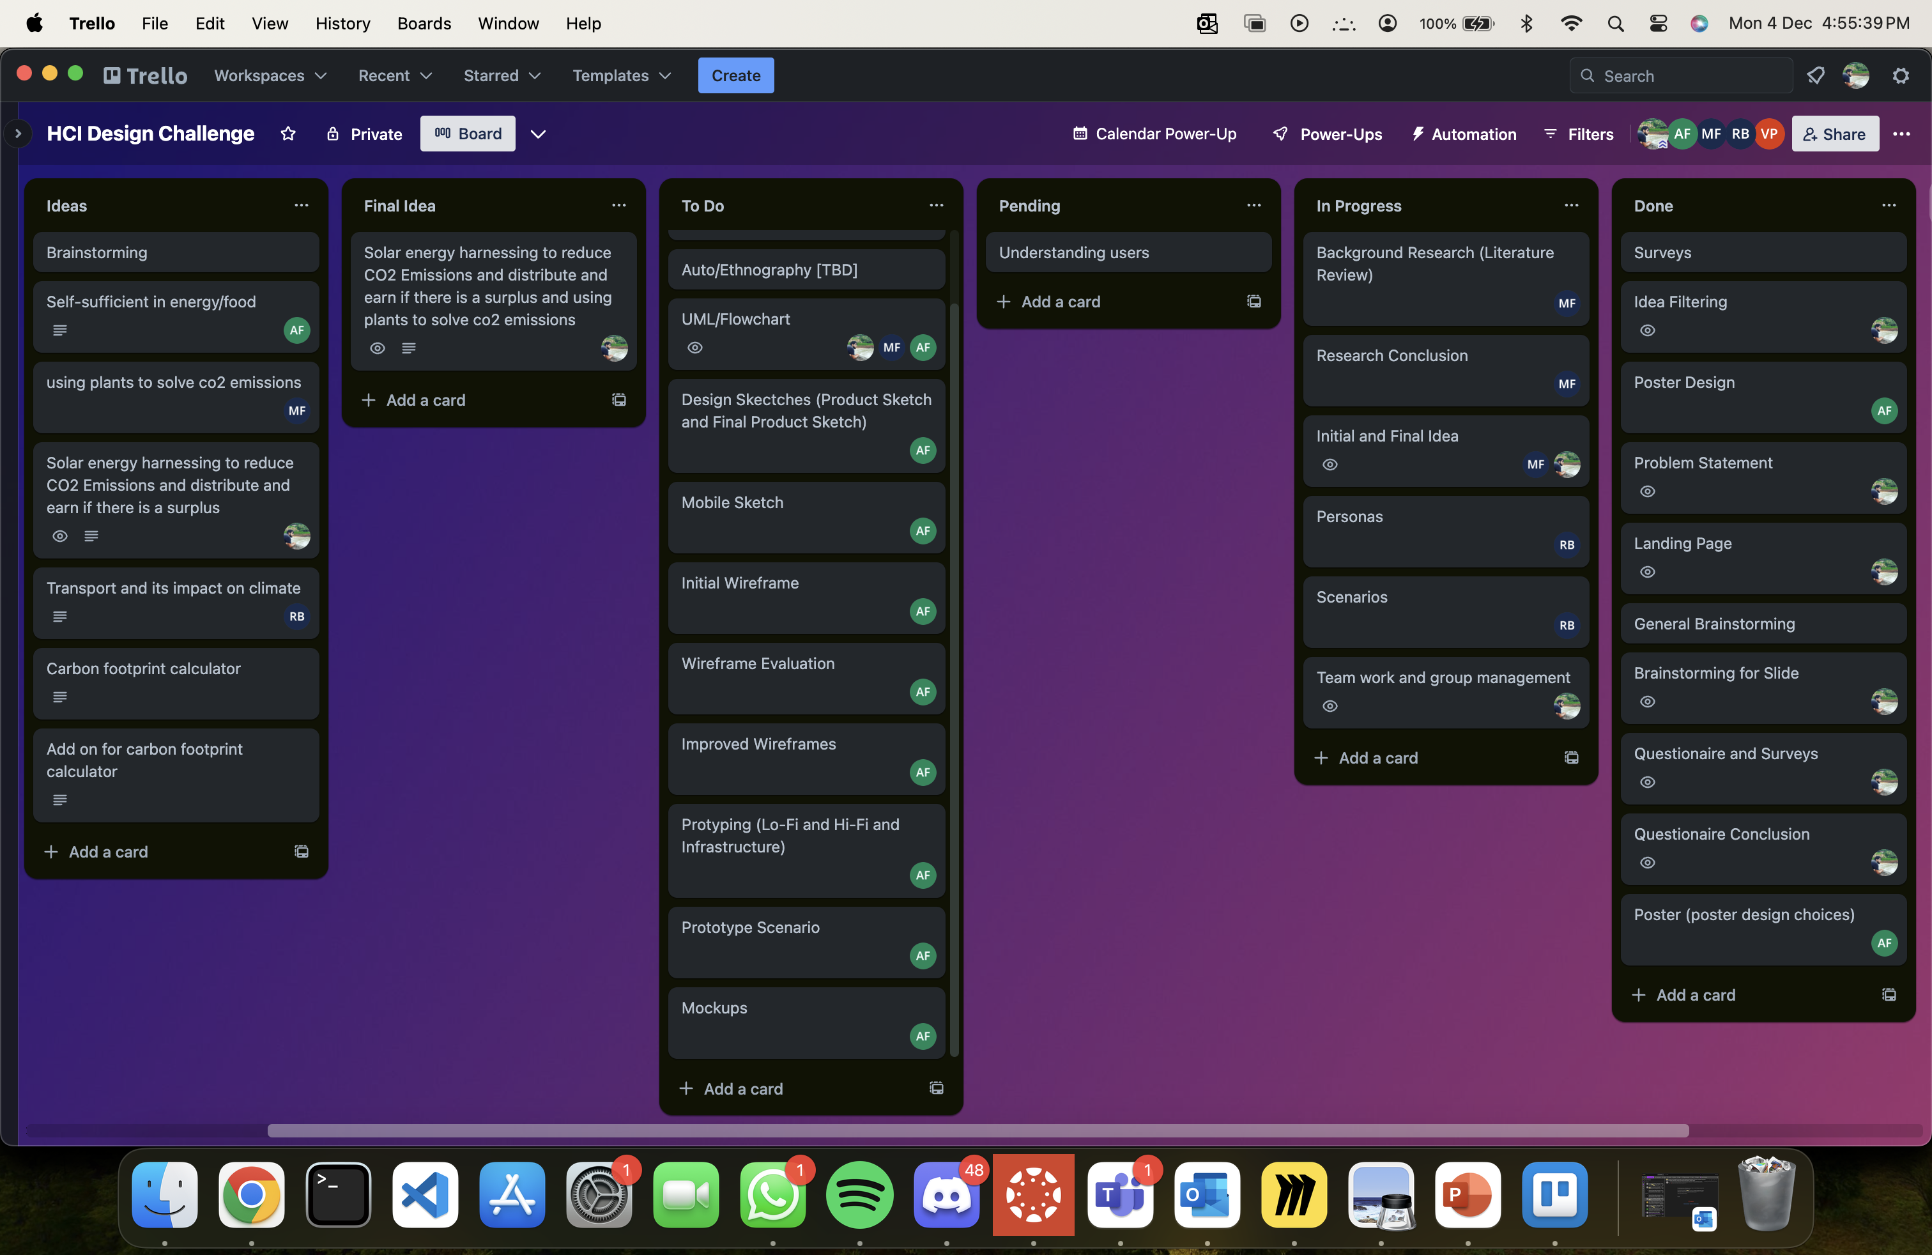
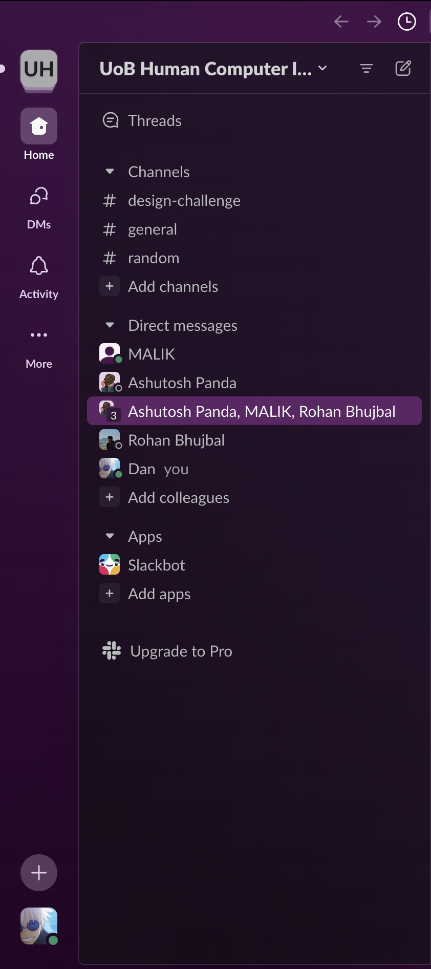
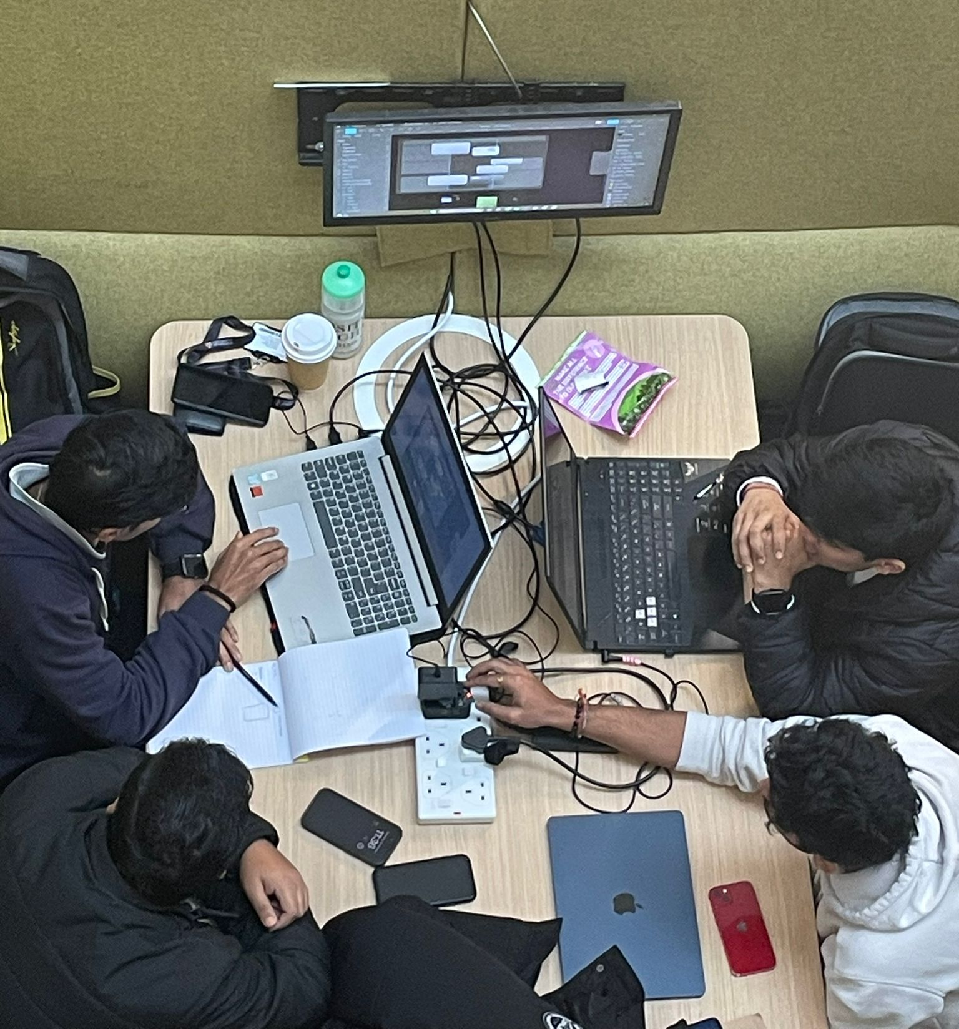
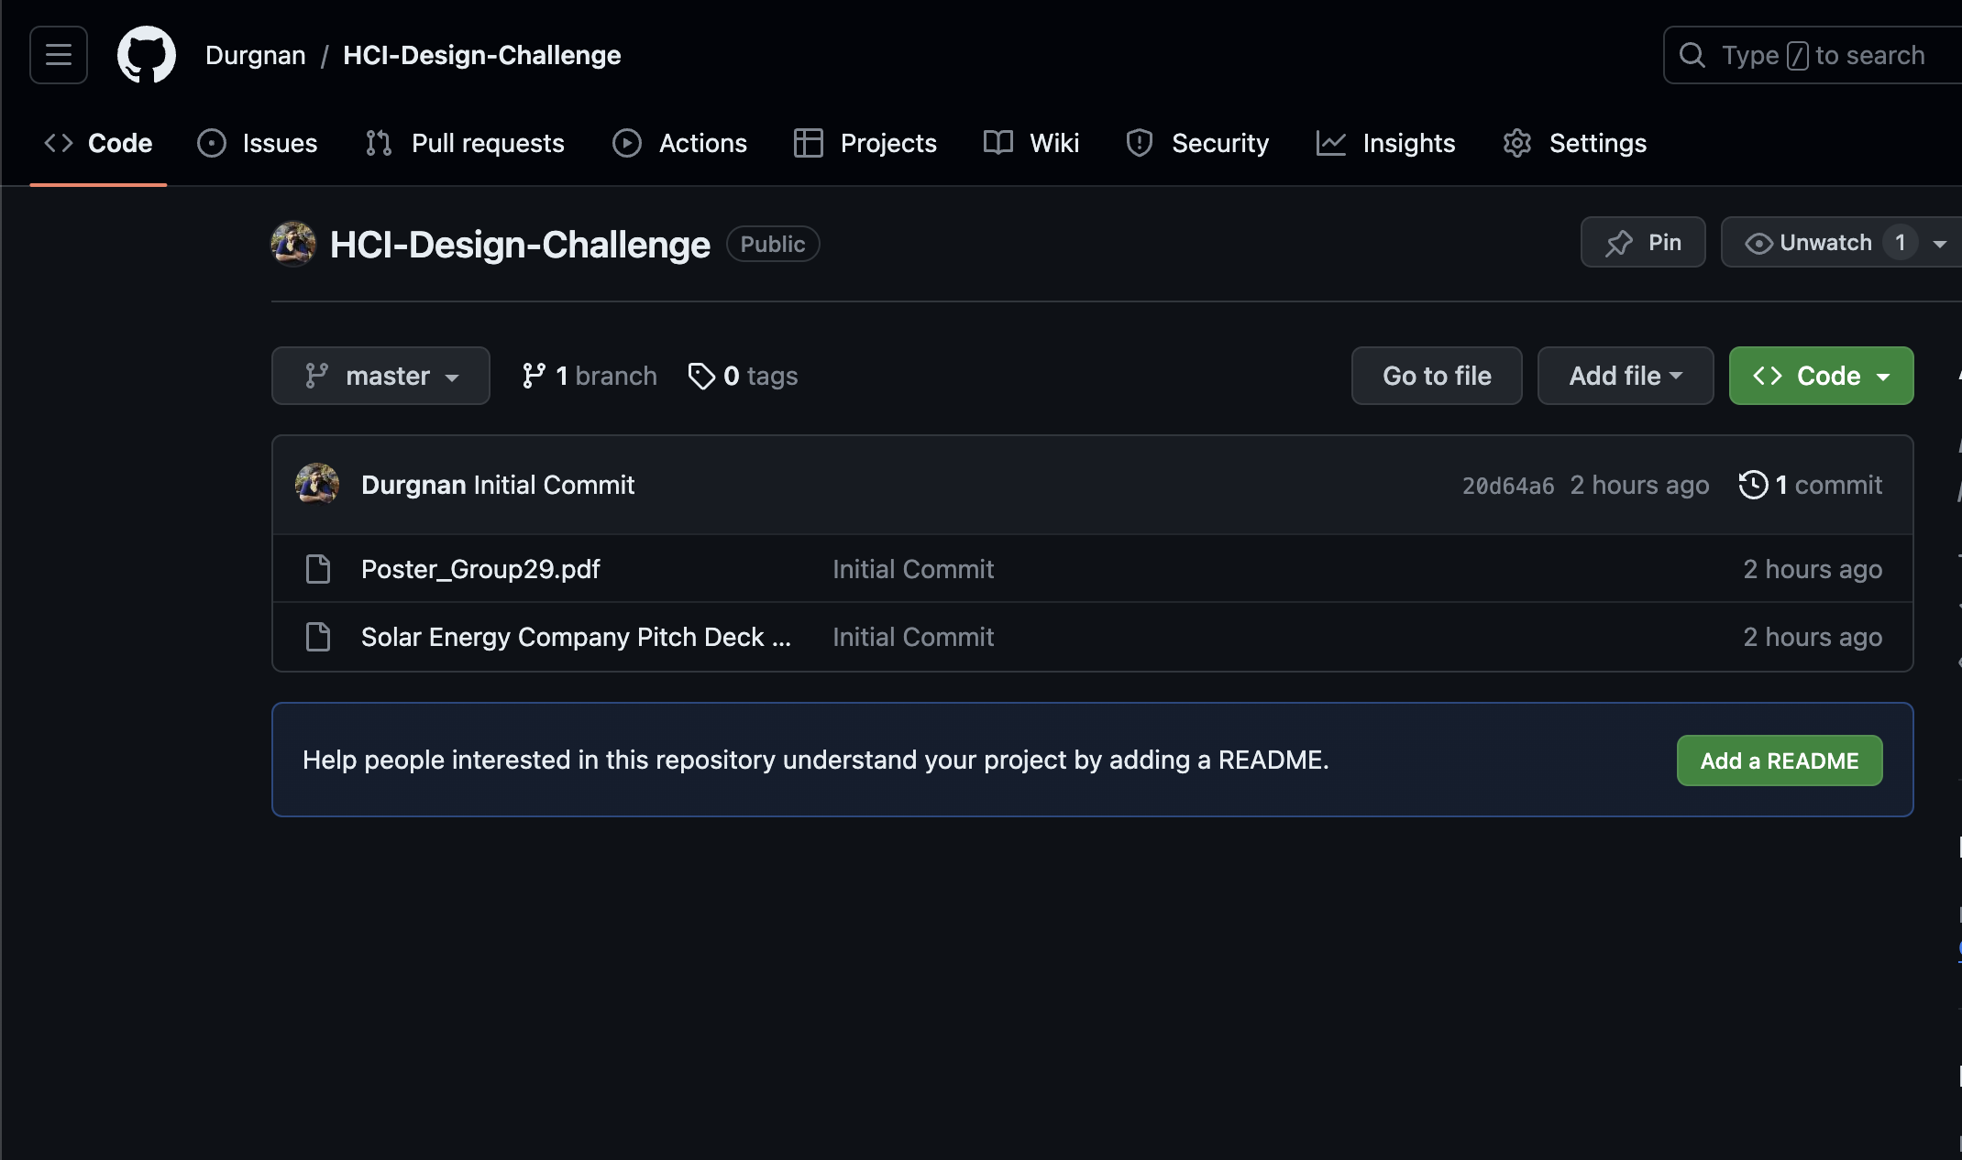
Group Work Management
The tools we used to work for our project is as follows:
Trello: User Stories tracking
Slack: chat workspace and a place for scheduled and adhoc calls.
GitHub: to maintain and manage changes of all the documents and codes in a safe repository.
Figma: For wireframing and prototyping
Miro: For brainstorming ideas and research

Slide 48
THANK YOU

Slide 49
INTRODUCTION
SOLAR ENERGY COMPANY - SOLAR ENERGY COMPANY - SOLAR ENERGY COMPANY
Mercury is the closest planet to the Sun and the smallest one in the Solar System—it’s only a bit larger than the Moon. The planet’s name has nothing to do with the liquid metal, since Mercury was named after the Roman messenger god
SOLAR ENERGY COMPANY - SOLAR ENERGY COMPANY - SOLAR ENERGY COMPANY

Slide 50
OUR COMPANY
Mercury is the closest planet to the Sun and the smallest one in the Solar System—it’s only a bit larger than the Moon. The planet’s name has nothing to do with the liquid metal
OUR COMPANY - OUR COMPANY - OUR COMPANY - OUR COMPANY - OUR COMPANY - OUR COMPANY

Slide 51
CONTENTS OF THIS TEMPLATE
This is a slide structure based on a pitch deck presentation
You can delete this slide when you’re done editing the presentation
FONTS | To view this template correctly in PowerPoint, download and install the fonts we used
USED AND ALTERNATIVE RESOURCES | An assortment of graphic resources that are suitable for use in this presentation
THANKS SLIDE | You must keep it so that proper credits for our design are given
COLORS | All the colors used in this presentation
INFOGRAPHIC RESOURCES | These can be used in the template, and their size and color can be edited
CUSTOMIZABLE ICONS | They are sorted by theme so you can use them in all kinds of presentations
For more info: SLIDESGO | SLIDESGO SCHOOL | FAQS
You can visit our sister projects: FREEPIK | FLATICON | STORYSET | WEPIK | VIDFY
CONTENTS OF THIS TEMPLATE - CONTENTS OF THIS TEMPLATE - CONTENTS OF THIS TEMPLATE

Slide 52
THEM
US
Mercury is the closest planet to the Sun and the smallest one in the Solar System—it’s only a bit larger than the Moon
Venus has a beautiful name and is the second planet from the Sun. It’s hot and has a poisonous atmosphere
SOLAR ENERGY COMPANY - SOLAR ENERGY COMPANY - SOLAR ENERGY COMPANY

Slide 53
320,000
SOLAR ENERGY COMPANY - SOLAR ENERGY COMPANY
Big numbers catch your audience’s attention
SOLAR ENERGY COMPANY - SOLAR ENERGY COMPANY

Slide 54
SOLUTION
Venus has a beautiful name and is the second planet from the Sun. It’s terribly hot—even hotter than Mercury—and its atmosphere is extremely poisonous
SOLUTION - SOLUTION - SOLUTION - SOLUTION - SOLUTION - SOLUTION

Slide 55
SWOT ANALYSIS
STRENGTHS
WEAKNESSES
OPPORTUNITIES
THREATS
S
Mercury is the smallest planet of them all
W
Venus has a beautiful name, but also high temperatures
O
Earth is the beautiful planet where we all live on
T
Despite being red, Mars is actually a cold place
SWOT ANALYSIS - SWOT ANALYSIS - SWOT ANALYSIS
SWOT ANALYSIS - SWOT ANALYSIS - SWOT ANALYSIS - SWOT ANALYSIS

Slide 56
PRODUCT OVERVIEW
MERCURY
VENUS
EARTH
MARS
SATURN
Mercury is the smallest planet of them all
Venus is the second planet from the Sun
Earth is the only planet known to harbor life
Despite being red, Mars is actually a cold place
Saturn is not the only planet with rings
PRODUCT OVERVIEW - PRODUCT OVERVIEW - PRODUCT OVERVIEW

Slide 57
OUR PLANS
BASIC
PRO
PREMIUM
$10,000
$19,000
$26,000
Mercury is the closest planet to the Sun and the smallest of them all
Venus has a beautiful name and is the second planet from the Sun
Despite being red, Mars is actually a cold place. It's full of iron oxide dust
OUR PLANS - OUR PLANS - OUR PLANS - OUR PLANS - OUR PLANS - OUR PLANS

Slide 58
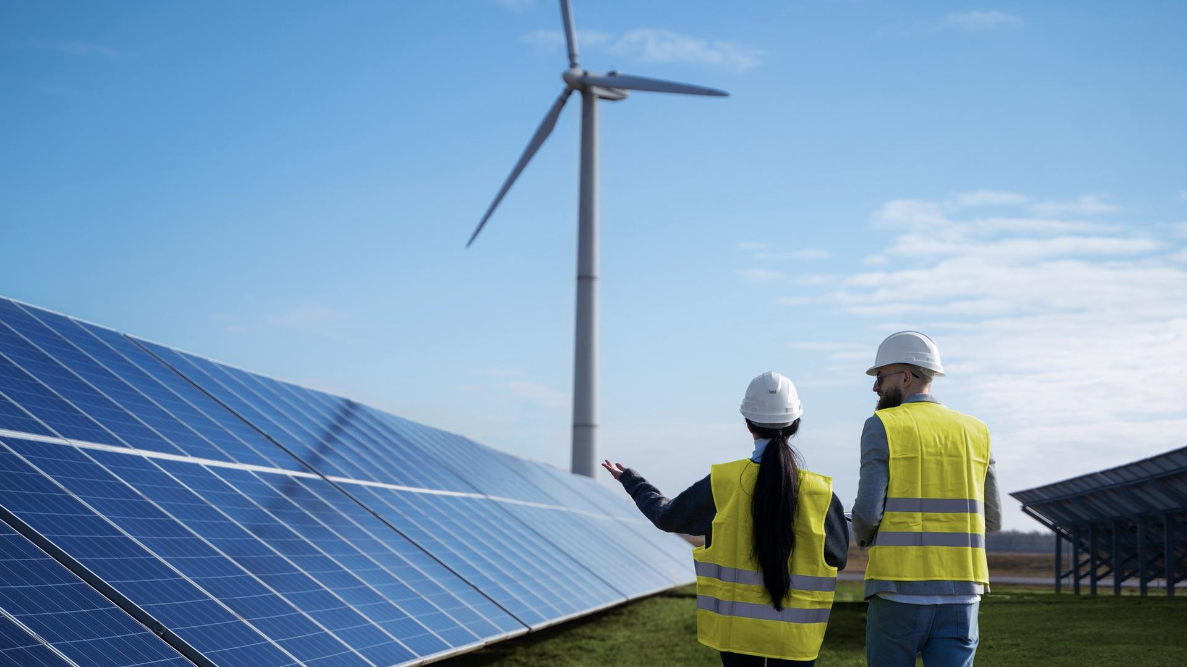
A PICTURE IS WORTH A THOUSAND WORDS
SOLAR ENERGY COMPANY - SOLAR ENERGY COMPANY - SOLAR ENERGY COMPANY
SOLAR ENERGY COMPANY - SOLAR ENERGY COMPANY - SOLAR ENERGY COMPANY

Slide 59
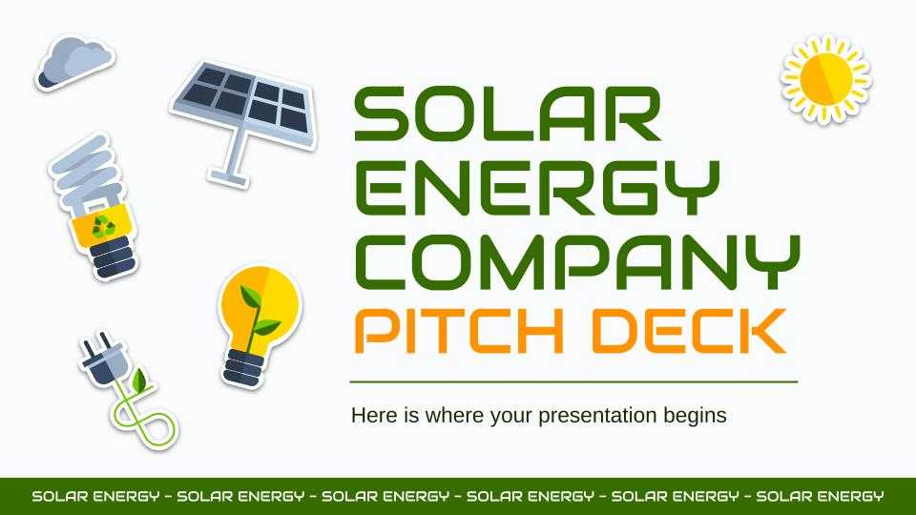
PRODUCT DEMO
You can replace the image on the screen with your own work. Just right-click on it and select “Replace image”
SOLAR ENERGY COMPANY - SOLAR ENERGY COMPANY

Slide 60
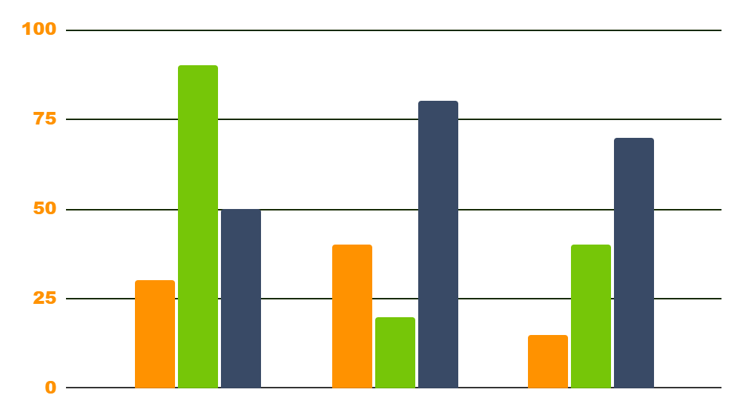
TRACTION
$140,000
12,000
$150
150,000,00$
JUPITER
VENUS
MARS
Gross revenues in 2021
Gross revenue in 2020
Registered businesses
Home energy savings
Follow the link in the graph to modify its data and then paste the new one here. For more info, click here
TRACTION - TRACTION - TRACTION - TRACTION - TRACTION - TRACTION - TRACTION

Slide 61
AWESOME WORDS
SOLAR ENERGY COMPANY - SOLAR ENERGY COMPANY
SOLAR ENERGY COMPANY - SOLAR ENERGY COMPANY

Slide 62
CASE STUDY
CHALLENGE
BUDGET
RESULTS
SOLUTIONS
Despite being red, Mars is actually a cold place full of iron oxide dust
Jupiter is a gas giant and the biggest planet in the entire Solar System
Venus has a beautiful name and is the second planet from the Sun
Saturn is a gas giant, composed mostly of hydrogen and helium
CASE STUDY - CASE STUDY - CASE STUDY - CASE STUDY - CASE STUDY

Slide 63

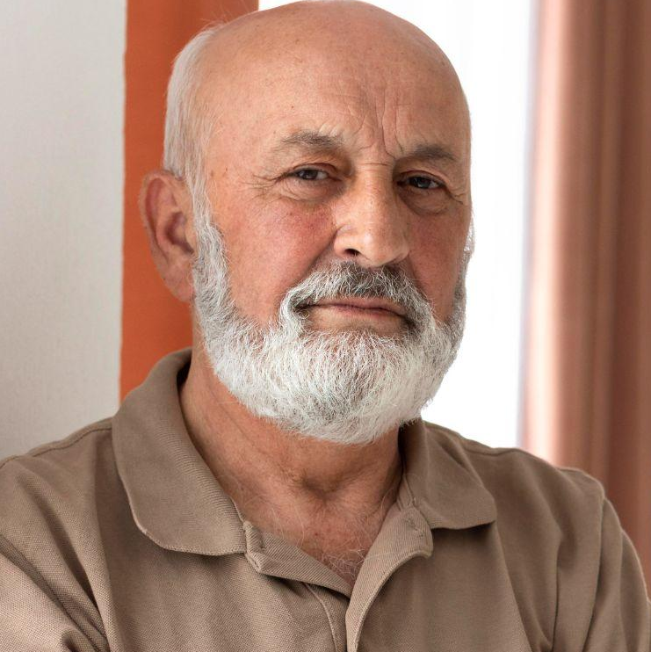
REVIEWS
NICOLE WILLS
RON SMITH
“Mercury is the closest planet to the Sun and the smallest one in the Solar System”
“Jupiter is the biggest planet in the Solar System and the fourth-brightest object in the sky”
REVIEWS - REVIEWS - REVIEWS - REVIEWS - REVIEWS - REVIEWS - REVIEWS

Slide 64
LATEST AWARDS
MERCURY
JUPITER
NEPTUNE
Mercury is the smallest planet of them all
Jupiter is the biggest planet of them all
Neptune is the farthest planet from the Sun
AWARDS - AWARDS - AWARDS - AWARDS - AWARDS - AWARDS - AWARDS - AWARDS

Slide 65
—SOMEONE FAMOUS
SOLAR ENERGY COMPANY - SOLAR ENERGY COMPANY
“This is a quote, words full of wisdom that someone important said and can make the reader get inspired.”
SOLAR ENERGY COMPANY - SOLAR ENERGY COMPANY

Slide 66
MARKET SIZE
60%
40%
MERCURY
VENUS
Mercury is the closest planet to the Sun
Venus is the second planet from the Sun
MARKET SIZE - MARKET SIZE - MARKET SIZE - MARKET SIZE - MARKET SIZE - MARKET SIZE

Slide 67
TARGET
$200
AGE
SPEND PER CUSTOMER
10%
50%
40%
Venus has a beautiful name, but also high temperatures
23 - 30
31 - 45
46+
GENDER
INTERESTS
Man
30%
Devices
Home
Woman
50%
Others
20%
Savings
Transportation
TARGET - TARGET - TARGET - TARGET - TARGET - TARGET - TARGET - TARGET - TARGET

Slide 68
OUR COMPETITORS
 | COMPETITOR A | COMPETITOR B | COMPETITOR C
DESCRIPTION | Mercury is the smallest planet of them all | Venus is terribly hot, even hotter than Mercury | Phobos and Deimos are both Mars’s moons
CHARACTERISTIC | Despite being red, Mars is actually a cold place | Jupiter is a gas giant planet in the Solar System | Saturn is a gas giant and has several rings
PRODUCT | Neptune is the farthest planet from the Sun | Earth is where we all live on and a blue planet | The Sun is the star at the center of the Solar System
COMPETITORS - COMPETITORS - COMPETITORS - COMPETITORS - COMPETITORS

Slide 69
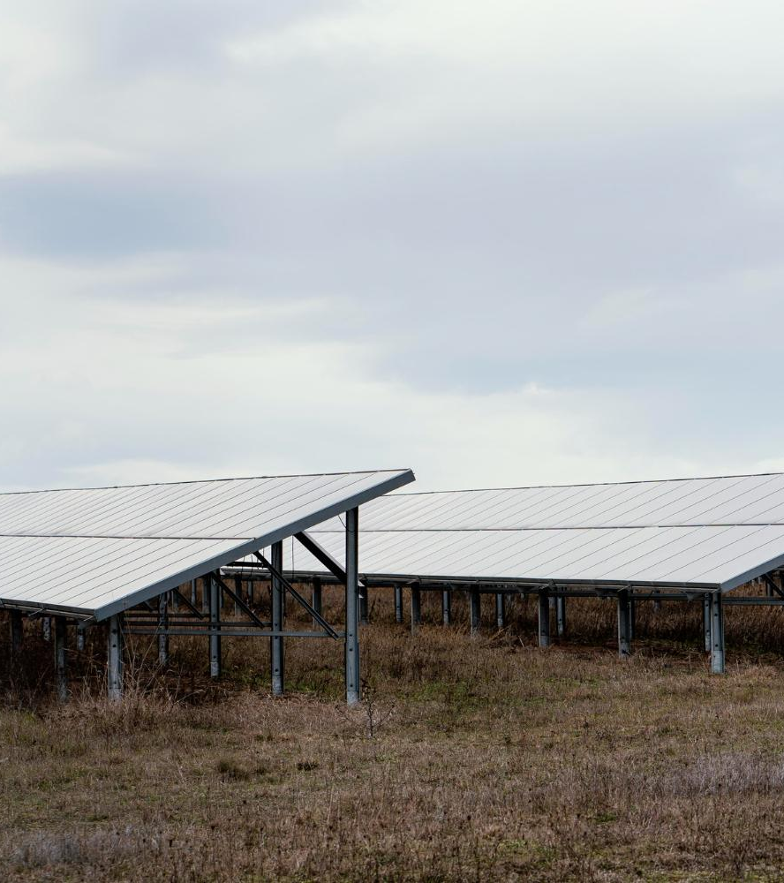
A PICTURE ALWAYS REINFORCES THE CONCEPT
SOLAR ENERGY COMPANY - SOLAR ENERGY COMPANY - SOLAR ENERGY COMPANY
Images reveal large amounts of data, so remember: use an image instead of a long text. Your audience will appreciate it
SOLAR ENERGY COMPANY - SOLAR ENERGY COMPANY - SOLAR ENERGY COMPANY

Slide 70
BUSINESS MODEL
SATURN
EARTH
JUPITER
VENUS
MARS
MERCURY
Saturn is not the only planet with rings
Earth is the only planet known to harbor life
Jupiter is the biggest planet of them all
Venus is the second planet from the Sun
Despite being red, Mars is actually a cold place
Mercury is the smallest planet of them all
BUSINESS MODEL - BUSINESS MODEL - BUSINESS - BUSINESS - BUSINESS

Slide 71
TIMING
WEEK 01
WEEK 02
WEEK 03
WEEK 04
MARS
VENUS
SATURN
JUPITER
Despite being red, Mars is cold
Venus has a beautiful name
Saturn is a gas giant with rings
Jupiter is a very big planet
TIMING - TIMING - TIMING - TIMING - TIMING - TIMING - TIMING - TIMING - TIMING - TIMING

Slide 72
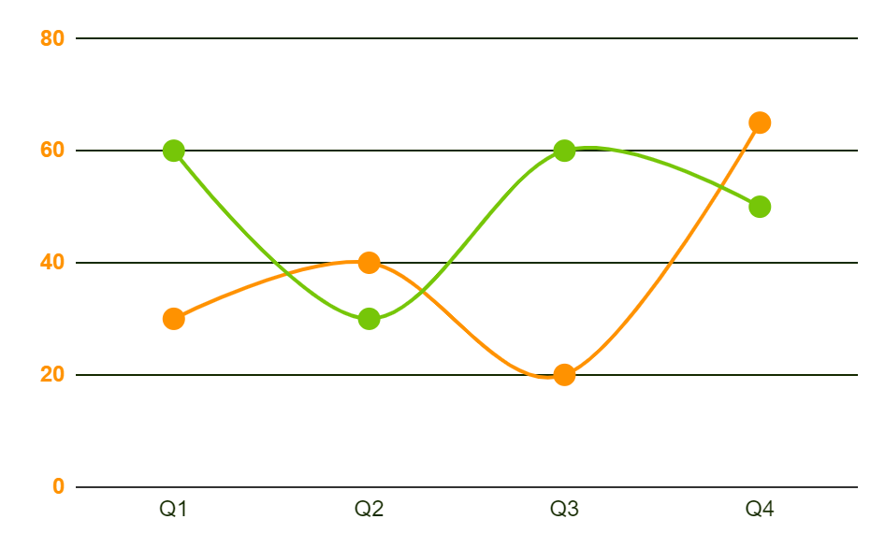
PREDICTED GROWTH
80%
$60M
Increased income
Expected income
65%
2,000
More employees
Total employees
Follow the link in the graph to modify its data and then paste the new one here. For more info, click here
PREDICTED GROWTH - PREDICTED GROWTH - PREDICTED GROWTH - PREDICTED GROWTH

Slide 73
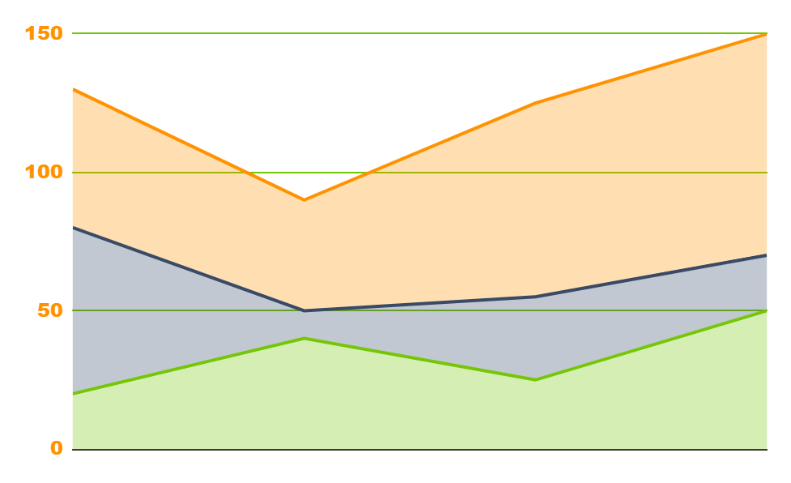
INVESTMENT
VENUS
20%
Venus is the second planet from the Sun
MARS
30%
Mars is full of iron oxide dust
EARTH
50%
Earth is the third planet from the Sun
2020
2021
2022
Follow the link in the graph to modify its data and then paste the new one here. For more info, click here
INVESTMENT - INVESTMENT - INVESTMENT - INVESTMENT - INVESTMENT - INVESTMENT

Slide 74
9h 55m 23s
333,000
386,000 km
SOLAR ENERGY COMPANY - SOLAR ENERGY COMPANY - SOLAR ENERGY COMPANY
Jupiter's rotation period
The Sun’s mass compared to Earth’s
Distance between Earth and the Moon
SOLAR ENERGY COMPANY - SOLAR ENERGY COMPANY - SOLAR ENERGY COMPANY

Slide 75
THANKS!
THANKS! - THANKS! - THANKS! - THANKS!
Do you have any questions?
addyouremail@freepik.com
+91 620 421 838
yourwebsite.com
Please keep this slide for attribution
THANKS! - THANKS! - THANKS! - THANKS!

Slide 76
ICON PACK
SOLAR ENERGY COMPANY - SOLAR ENERGY COMPANY

Slide 77
ALTERNATIVE RESOURCES
Here’s an assortment of alternative resources whose style fits the one of this template:
VECTORS
Eco energy flat icons
Isolated eco icon set
ALTERNATIVE RESOURCES - ALTERNATIVE RESOURCES - ALTERNATIVE RESOURCES

Slide 78
RESOURCES
Did you like the resources on this template? Get them for free at our other websites:
VECTORS
Ecology icons set
Eco energy flat icons
ICONS
Icon Pack: Ecology Test Task | Lineal color
PHOTOS
Portrait of a beautiful woman engineer
Medium shot smiley engineer holding tablet
Wind farms fields
Medium shot engineers discussing about solar panels
Field with lots of solar panels and copy space
Medium shot old man posing
Smiley woman looking at the phone with copy space
RESOURCES - RESOURCES - RESOURCES - RESOURCES - RESOURCES - RESOURCES

